Slide 1
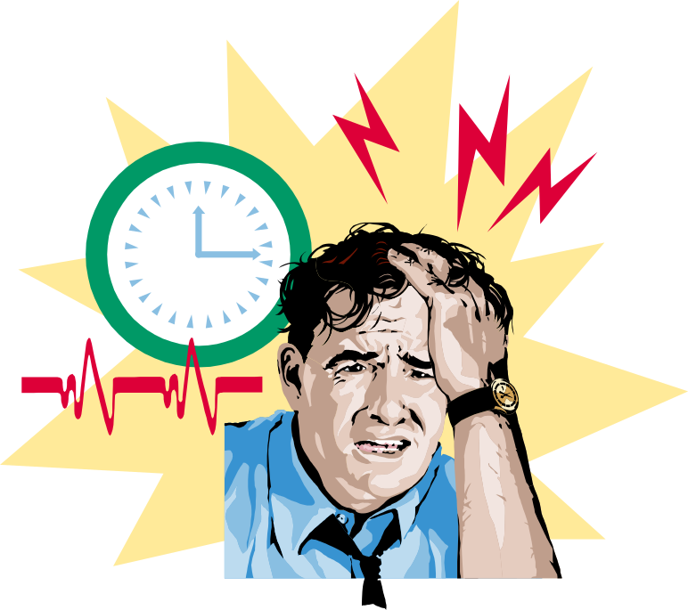

STRESS AND CONFLICT

Slide 2
Stress and its managements
Stress
Stress is a physiological and psychological response to a perceived threat or challenge. It is the body's natural response to demands or pressures from the environment, which can be either positive or negative.

Slide 3
Sources of stress
Environmental Factors
  Economic uncertainties of the business cycle
  Political uncertainties of political systems
  Technological uncertainties of technical innovations
  Terrorism is a threats to physical safety and security

Slide 4
Sources of stress
Organizational Factors
  Task demands related to the job
  Role demands of functioning in an organization
  Interpersonal demands created by other employees
  Organizational structure (rules and regulations)
  Organizational leadership (managerial style)
  Organization’s life stage (growth, stability, or decline)

Slide 5
Sources of stress
Individual Factors
  Family and personal relationships
  Economic problems from exceeding earning capacity
  Personality problems arising for basic disposition
Individual Differences
  Perceptual variations of how reality will affect the individual’s future.
  Greater job experience moderates stress effects.
  Social support buffers job stress.
  Internal locus of control lowers perceived job stress.
  Strong feelings of self-efficacy reduce reactions to job stress.

Slide 6
Consequences of Stress
High Levels
of Stress
Physiological
Symptoms
Psychological
Symptoms
Behavioral
Symptoms

Slide 7
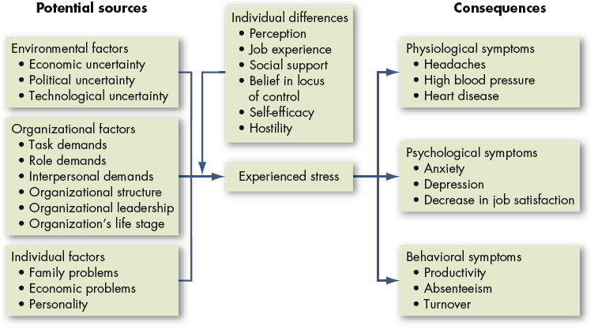
Model of stress

Slide 8
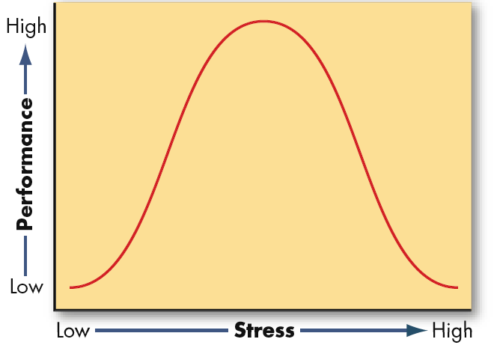
Relationship between stress and performance

Slide 9
Types of stress
There are three main types of stress. These are acute, episodic acute, and chronic stress. We explore each type of stress below.
Acute stress
The most common type of stress, acute stress, can be helpful in short doses. It is the body’s response to a recent or anticipated challenge or unexpected event.
Common symptoms of acute stress include:
emotional distress
muscle tension
headache, back pain, or jaw ache
stomach upset
rapid heartbeat

Slide 10
Types of stress
Episodic acute stress
Episodic acute stress is when a person experiences acute stress frequently.
If you have episodic acute stress, you may feel like you are always under pressure or that things are always going wrong. This can be exhausting, both physically and mentally.
Experiencing episodic acute stress symptoms may affect the way you behave towards others. Left untreated, episodic acute stress can lead to:
irritability
unintended hostility
relationship problems

Slide 11
Types of stress
Chronic stress
Chronic stress is ongoing stress resulting from long-term emotional pressure. For example, a stressful job, unhappy family situation, or money problems.
If you have chronic stress, your body experiences the fight or flight response too frequently to recover between episodes. This means your nervous system is constantly aroused, which is not good for your health.
Left untreated, chronic stress can cause physical health problems. Research links chronic stress to heart disease and problems with the immune system. Up to 43 percent of adults experience adverse health effects from stress.

Slide 12
MANAGING STRESS
Individual Approaches
  Implementing time management
  Increasing physical exercise
  Relaxation training
  Expanding social support network

Slide 13
MANAGING STRESS
Organizational Approaches
  Improved personnel selection and job placement
  Training
  Use of realistic goal setting
  Redesigning of jobs
  Increased employee involvement
  Improved organizational communication
  Offering employee sabbaticals
  Establishment of corporate wellness programs

Slide 14


Slide 15
CONFLICT
  Is a process that begins when one party perceives that another party has negatively affected, or is about to negatively affect, something that the first party cares about.
    Is that point in an ongoing activity when an interaction “crosses over” to become an interparty conflict.
  Encompasses a wide range of conflicts that people experience in organizations
    Incompatibility of goals
    Differences over interpretations of facts

Slide 16
Transitions in Conflict Thought
Traditional View
The traditional view of conflicts has been around since late nineteenth century. According to this view, the conflicts are always bad for an organization. It always leads to failure and always has a negative impact on the performance of an organization. According to this view, a conflict is synonymous to violence, destruction and irrationality. According to the traditional view, a conflict must always be avoided at all costs. The manager should try to reduce, suppress or eliminate it. The manager is allowed to take authoritative approach to rid the organization of conflicts. The problem with this view is that the root cause of the conflict is left undetermined.

Slide 17
Transitions of conflict thought
Human Relations View
Human Relations view is also referred to as managed view. While the traditional view relates the conflicts with destruction and a negative impact and tries to ensure the removal of conflict, the human relations view acknowledges the existence of conflict in an organization. According to this view, in an organization, conflict is inevitable and natural. A conflict has the potential to have a positive impact on the performance of an organization. A conflict cannot be totally eradicated and there are times when this conflict may even benefit an organization. The managers should accept the conflict and should try to manage it effectively instead of suppressing or totally eliminating it . They should not allow the conflict to increase more than a certain level and they should also not leave the conflict unresolved. This may lead toward the decrease in performance.

Slide 18
Transitions of conflict thought
interactionist view
According to this view, a conflict is mandatory for an organization’s better performance. According to Andersen (2009), a conflict helps an organization to cope with changes in a better way. This view encourages the conflicts based on the rationale that if there is no conflict in an organization, it may become stagnant, lethargic and non-responsive to needs for change and improvement.

Slide 19
Functional versus Dysfunctional Conflict
Functional Conflict
Conflict that supports the goals of the group and improves its performance.
Dysfunctional Conflict
Conflict that hinders group performance

Slide 20
Types of conflict
Task Conflict
Conflicts over content and goals of the work.
Relationship Conflict
Conflict based on interpersonal relationships.
Process Conflict
Conflict over how work gets done.

Slide 21
Stages in conflict
Latent Stage: Participants not yet aware of conflict
Perceived Stage: Participants aware a conflict exists
Felt Stage: Stress and anxiety
Manifest: Conflict is open and can be observed
Aftermath: Outcome of conflict, resolution or dissolution

Slide 22
Conflict Management
The use of resolution and stimulation techniques to achieve the desired level of conflict.

Slide 23
Conflict Management Techniques
Problem solving
Superordinate goals
Expansion of resources
Avoidance
Smoothing
Compromise
Authoritative command
Altering the human variable
Altering the structural variables

Slide 24
Conflict resolution strategies
Competing
A desire to satisfy one’s interests, regardless of the impact on the other party to the conflict.
Collaborating
A situation in which the parties to a conflict each desire to satisfy fully the concerns of all parties.
Avoiding
The desire to withdraw from or suppress a conflict.

Slide 25
Conflict resolution strategies
Accommodating
The willingness of one party in a conflict to place the opponent’s interests above his or her own.
Compromising
A situation in which each party to a conflict is willing to give up something.

Slide 26
Advantages of conflict
It encourages healthy debate and argument:
Allows your team to work towards their goals
Brings inside the working environment a sense of commitment:
Clarifies all doubts and queries:
Removes all stress and anxiety
Increases Productivity Immensely:
New ideas are created in the process:
Improves relationships among people:

Slide 27
Disadvantages of Conflicts
Increased stress and anxiety among individuals, which decreases productivity and satisfaction
Feelings of being defeated and demeaned, which lowers individuals’ morale and may effect turnover
A climate of mistrust, which hinders the teamwork and cooperation necessary to get work done
Destruction of properties

